Slide 1


GAME SERVER QUEUE PROBLEM
Team Members:
Murat DEMİRCİ - 181005035
Barış İLGİN - 181005049

Slide 2
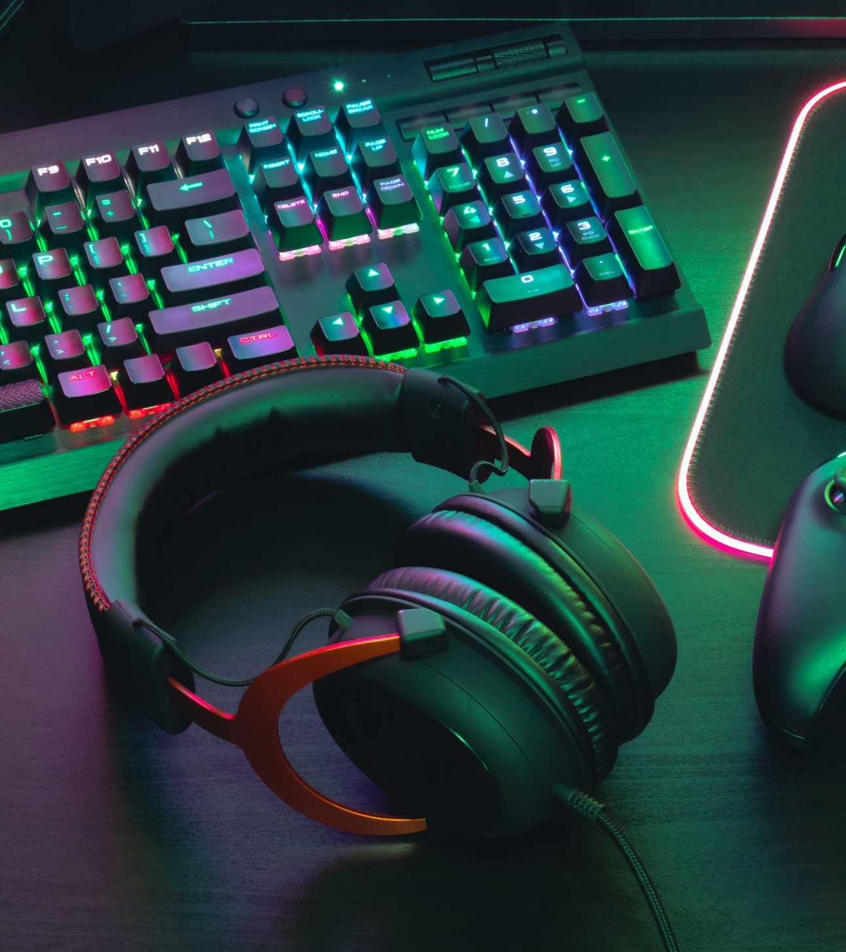
What is the problem of game server?
The main problem of that is there may happen excess demand while players try to enter the servers and channels at the exactly same time and this may cause of huge troubles and losing players and potential players.

Slide 3

What Is the purpose of our project?
We want to solve the most important problem waiting in the queues. How do we solve this:
Queuing problems occur when trying to access servers and channels. In case of overload of servers and channels like this, we will solve the problem by equally distributing servers and channels.

Slide 4
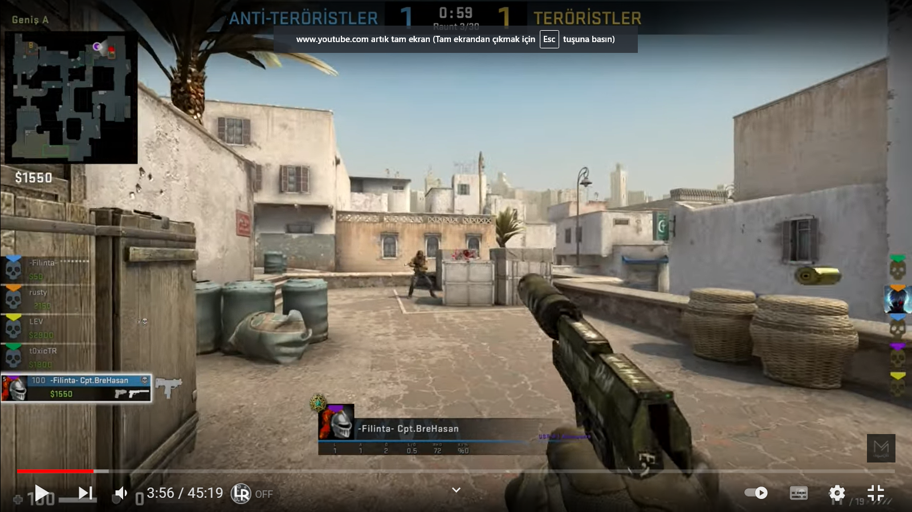
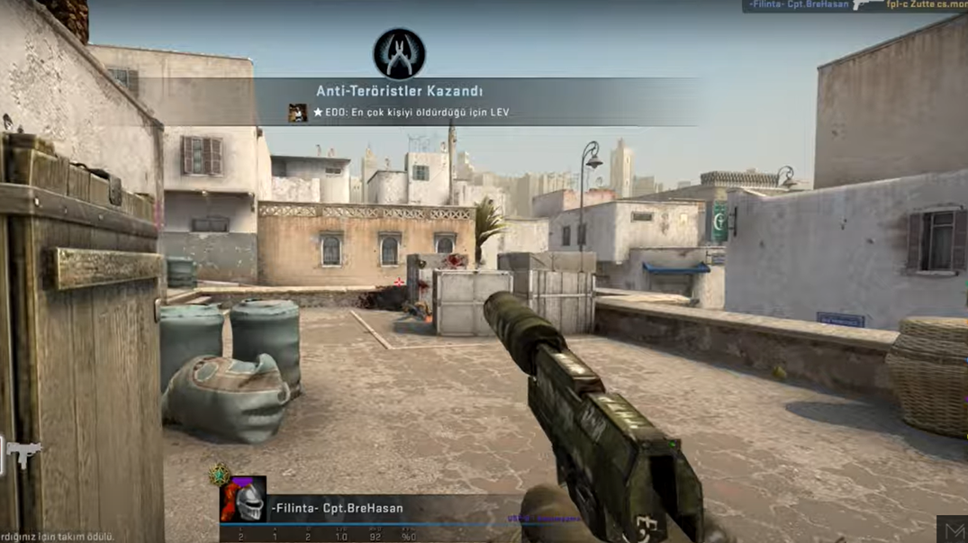
How gamıng servers work
The data packet has sent to the server. After that the server receives the information and sends another data packet, known as the response packet, acknowledging the receipt of the packet.

Slide 5

THANK YOU FOR LISTENING US

